Slide 1

Statistical and Predictive Modeling for Analytics II
Assignment – 1
K-NN Regression Model
Presented By
Kartik Sojitra (100723768)

Slide 2

Table of Contents
Description Of The Problem
Learning Curve of the k-NN Regression Model
Standard and Optimized k-NN Model
Recommendations

Slide 3

Description of the Problem
Mr. John Hughes has difficulty to distinguish how the different independent variables are affecting the dependent variable (CMS).
To solve the above problem he is creating a standard and optimized k-NN regression model.
Furthermore, the dataset is likely to be more difficult by analyzing the independent variables and the dependent variable.
In the dataset, there are 8 independent variables (Cement, Blast, Fly Ash, Water, Superplast, CA, FA, Age) and 1 dependent variable (CMS).

Slide 4
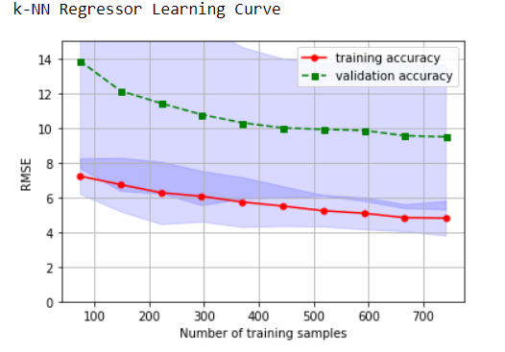
Learning Curve of the k-NN Regression Model
X = Number of training samples
Y = RMSE
Test size = 0.2
random_state = 100
Scoring = neg_mean_squared_error
cv = 10
n_jobs = 1
Con’t…

Slide 5
The k-NN regression learning curve compares the performance of a model on training and testing data over a varying number of training instances.
The gap between the training and validation accuracy is high which represent that this model is suffers from high variance.
We can determine from the graph that there is problem of overfitting and to resolve this problem we can collect more training data, reduce the complexity of the model.
Here our y-axis is ‘RMSE', not ‘SCORE', so the lower the RMSE , the better the performance of the model.

Slide 6
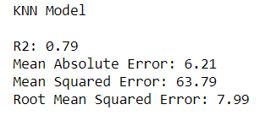
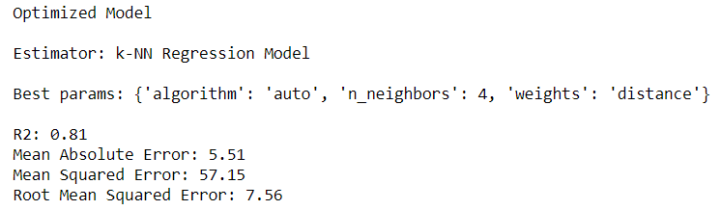
Standard and Optimized k-NN Regression Model
Con’t…

Slide 7
The R2 value for the standard k-NN regression model is 0.79 which is not good as an optimized k-NN regression model which is 0.81 that reveals that the optimized model is more fitted to the regression model.
The values of mean absolute error, mean squared error and root mean squared error of the standard k-NN model are less compared to optimize the k-NN model.
The optimized k-NN model measures the performance of a given predictive model on new test data sets and the RMSE value of the optimized model is less compared to the standard model.
Therefore this model analyzes to predict the class of new data points based on the nearest neighbors. The value of K is considerably training-data dependent, increasing the position of several training data may direct to a significant decline in performance.

Slide 8
Recommendation
The value of root mean squared error of optimized k-NN regression model is 7.56, which is less than the RMSE of the standard k-NN model which implies our model was not exceptionally exact but can still make a sensibly great prediction.
The R2 value of the optimized k-NN regression model is 81% which means the model can explain more than 81% of the variation.
To solve the problem of overfitting and improve the learning curve Mr. John Hughes can collect more training data, reduce the complexity of the model.
To improve the R2 value and decrease all types of error Mr. John Hughes can transform and modify the datasets.

Slide 9


